Slide 1
Basic Electrical Technology
2. Magnetic Circuits & Electromagnetism
Lecture **
Parallel Magnetic Circuits

Slide 2
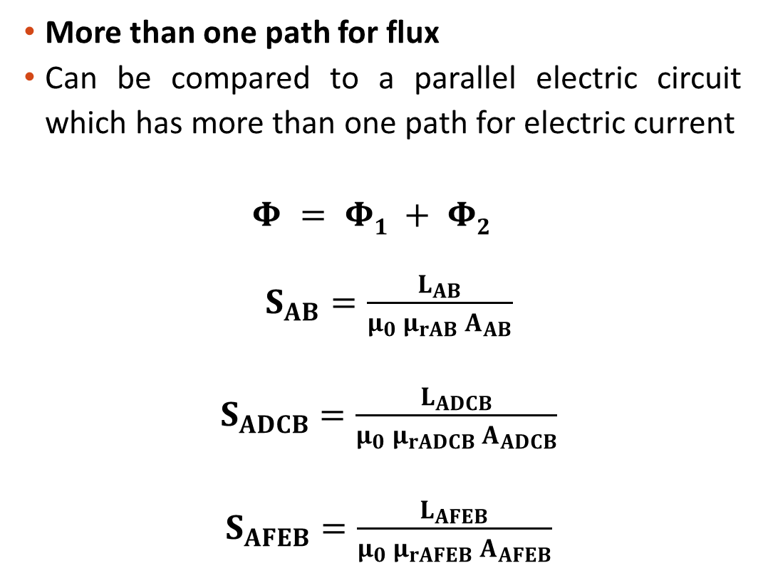
Parallel Magnetic Circuit
More than one path for flux
Can be compared to a parallel electric circuit which has more than one path for electric current
$$Φ = Φ1 + Φ2$$
$S_{AB}=\frac{L_{AB}}{μ_{0} μ_{rAB} A_{AB}}$
$S_{ADCB}=\frac{L_{ADCB}}{μ_{0} μ_{rADCB} A_{ADCB}}$
$S_{AFEB}=\frac{L_{AFEB}}{μ_{0} μ_{rAFEB} A_{AFEB}}$
F
Φ₂
Φ₁
A
D
N
Φ
B
C
E
Analogous Electrical Circuit

Slide 3
Parallel Magnetic Circuit
(MMF)_{Total} = (MMF)_{AB} + (MMF)_{ADCB}
OR
(MMF)_{Total} = (MMF)_{AB} + (MMF)_{AFEB}
(MMF)_{Total} = Φ S_{AB} + Φ₁ S_{ADCB}
OR
(MMF)_{Total} = Φ S_{AB} + Φ₂ S_{AFEB}
F
Φ₂
Φ₁
A
D
N
Φ
B
C
E
Analogous Electrical Circuit

Slide 4
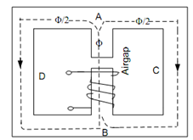
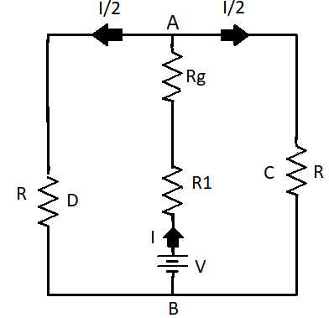
Parallel Magnetic Circuit with Air Gap
MMF required for this circuit would be the sum of:
that required for central limb (air-gap + core material) and,
that required for either of two parts (not both)

Slide 5
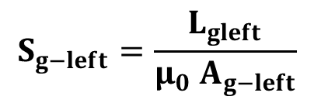
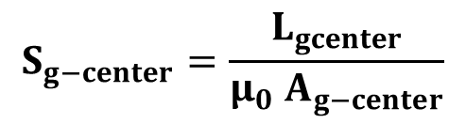
Parallel Magnetic Circuit with Air Gap
F
A
C
Φ₁
l_{g-center}
Φ₂
Φ
l_{g-left}
E
B
D
$S_{AFEB}=\frac{{(L}_{AFEB}−L_{gleft})}{μ_{0}{ μ}_{rAFEB} A_{AFEB}}$ $S_{AB}=\frac{{(L}_{AB}−L_{gcenter})}{μ_{0}{ μ}_{rAB} A_{AB}}$ ${ S}_{ACDB}=\frac{L_{ACDB}}{μ_{0}{ μ}_{rACDB} A_{ACDB}}$
$$S_{g−center}=\frac{L_{gcenter}}{μ_{0} A_{g−center}}$$
$$S_{g−left}=\frac{L_{gleft}}{μ_{0} A_{g−left}}$$

Slide 6

Illustration 6
A coil carrying a current of 2.8 A is wound on the left limb of the cast steel symmetrical frame of uniform square cross section of 16 cm² as shown. Calculate the number of turns in the coil to produce a flux of 1.8 mWb in the air gap of 0.2 cm length. The relative permeability of cast steel is 1200.
$Ans:1481$ Turns

Slide 7
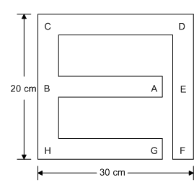

Illustration 7
The magnetic circuit shown is made of a material having relative permeability of 2000. The limb AB is wound with 1000 turns. Find the current through the coil to produce a flux of 4 mWb in the limb AB. The length of each air gap is 2 mm and the square cross-sectional area of the frame is 9 cm².
$$Ans:8.2554 A$$

Slide 8

Self-Practice 3
The magnetic circuit shown is made of a material having relative permeability of 2000. The central limb is wound with 1000 turns and has an air gap of length of 2 mm. The side limb air gap is 8 mm. Calculate the current required to set up a flux of 2.6 mWb in the central limb. Mean lengths of various sections are as follows: AB = 24 cm, ACDB = AFGHEB = 60 cm. Cross sectional area of the structure is 10 cm².
$$Ans:4.98 A$$

Slide 9
Self-Practice 4
A 710 turns coil is wound on the central limb of the cast steel symmetrical frame of uniform cross section 16 cm² is as shown. Calculate the current required to produce a flux of 1.8 mWb in an air gap of 0.2 cm length. Given L_{AFEB} = L_{ACDB} = 25 cm, L_{AB} = 12.5 cm. The magnetization details is as follows.
.
F
A
C
H | 300 | 500 | 600 | 700 | 900 | 1092
B | 0.1 | 0.45 | 0.562 | 0.775 | 1 | 1.125
Φ₂
Φ₃
Φ₁
E
D
B
Ans: 2.92 A

Slide 10
Basic Electrical Technology
2. Magnetic Circuits & Electromagnetism
Lecture **
Electromagnetic Induction and Coupled Circuits

Slide 11
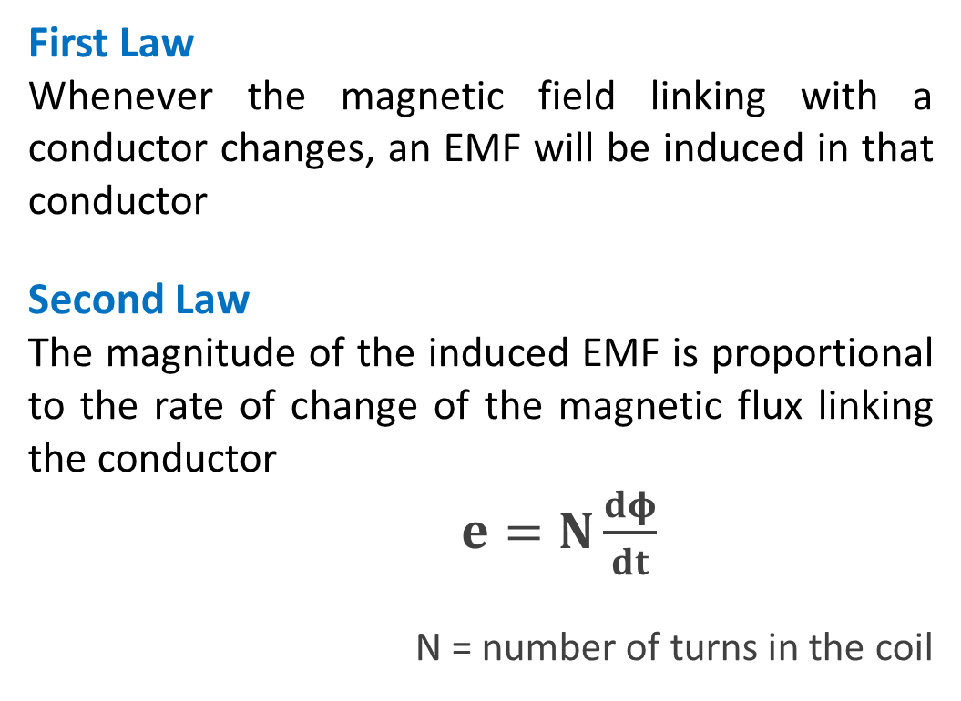
Faraday’s Laws of Electromagnetic Induction
First Law
Whenever the magnetic field linking with a conductor changes, an EMF will be induced in that conductor
Second Law
The magnitude of the induced EMF is proportional to the rate of change of the magnetic flux linking the conductor
$e=N\frac{dφ}{dt}$
N = number of turns in the coil
Notes:
Picture Courtesy: Google

Slide 12
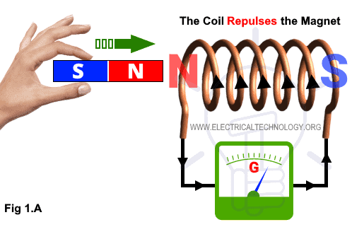
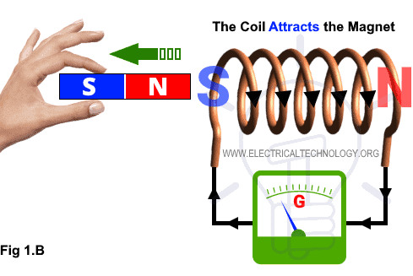
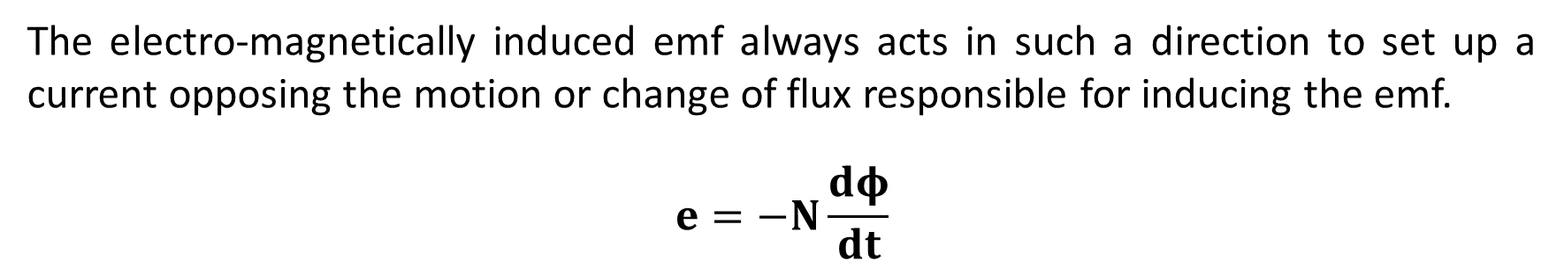
Lenz’s Law
The electro-magnetically induced emf always acts in such a direction to set up a current opposing the motion or change of flux responsible for inducing the emf.
$$e=−N\frac{dφ}{dt}$$
Notes:
Picture Courtesy: Google

Slide 13
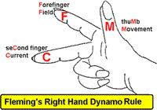
Fleming’s Right Hand Rule
If the first, second and the thumb of the right hand are held at right angles to each other,
first finger indicates the direction of the magnetic flux
and
thumb finger indicates the direction of motion of the conductor relative to the magnetic field,
then
the second finger represents the direction of induced EMF.
Notes:
Picture Courtesy: Google

Slide 14
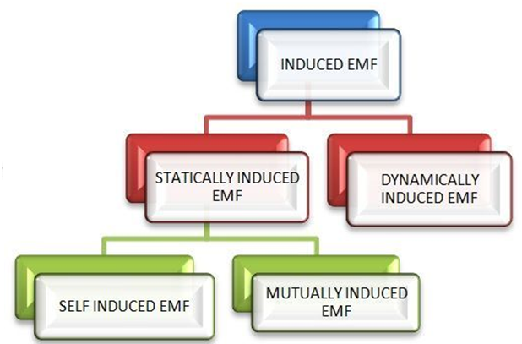
Types of Induced EMF
Notes:
Picture Courtesy: Google

Slide 15
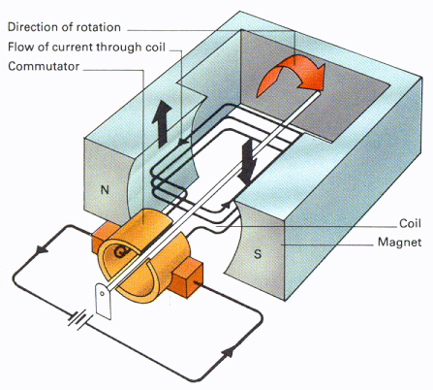
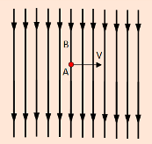
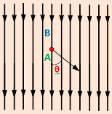
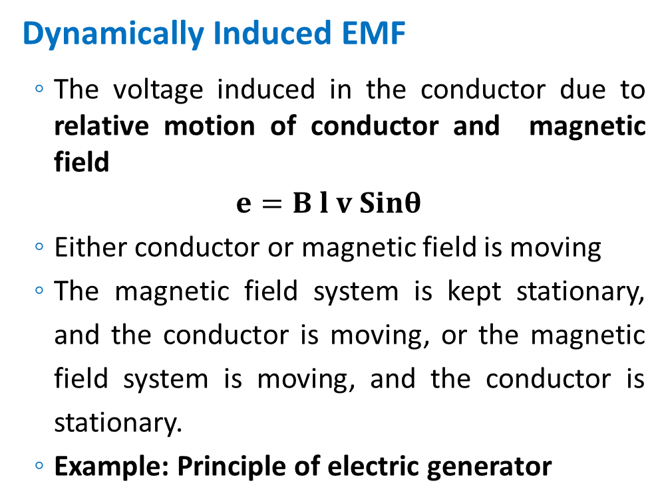
Types of Induced EMF
Dynamically Induced EMF
The voltage induced in the conductor due to relative motion of conductor and magnetic field
$$e=B l v Sinθ$$
Either conductor or magnetic field is moving
The magnetic field system is kept stationary, and the conductor is moving, or the magnetic field system is moving, and the conductor is stationary.
Example: Principle of electric generator
Notes:
Picture Courtesy: Google

Slide 16
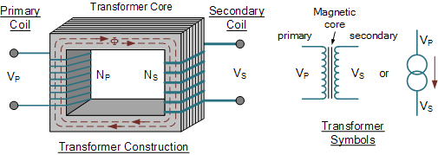

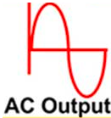
Types of Induced EMF
Statically induced EMF
The voltage induced in the conductor due to change in the magnetic field
Conductor is stationary
Magnetic field is changing in a stationary magnetic system
The change of flux produced by the field system linking with the coil is obtained by changing the electric current in the field system.
Example: Transformer
Notes:
Picture Courtesy: Google

Slide 17
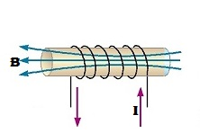
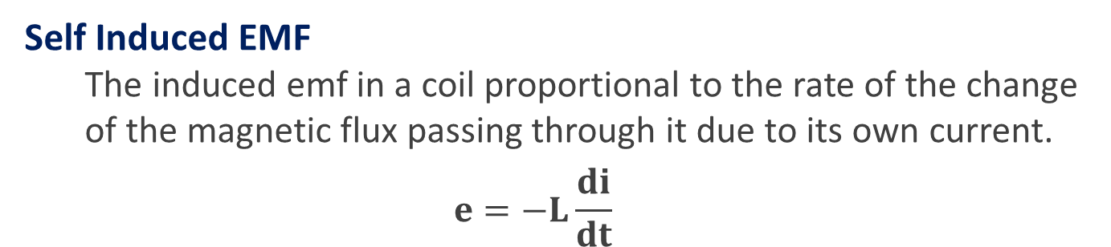
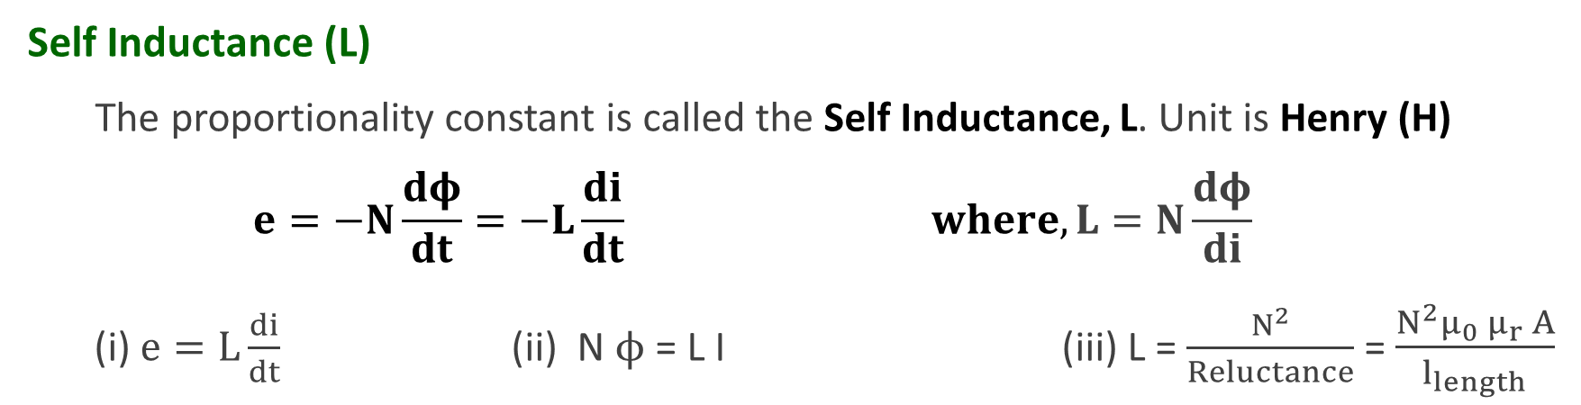
Types of Statically Induced EMF
Self Induced EMF
The induced emf in a coil proportional to the rate of the change of the magnetic flux passing through it due to its own current.
$$e=−L\frac{di}{dt}$$
Self Inductance (L)
The proportionality constant is called the Self Inductance, L. Unit is Henry (H)
$$e=−N\frac{dφ}{dt}=−L\frac{di}{dt} where, L=N\frac{dφ}{di}$$
(i) $e=L\frac{di}{dt}$ (ii) N $ϕ$ = L I (iii) L = $\frac{N^{2}}{Reluctance}$ = $\frac{N^{2}μ_{0}{ μ}_{r} A}{l_{length}}$
Notes:
Picture Courtesy: Google

Slide 18
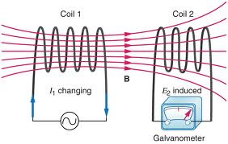
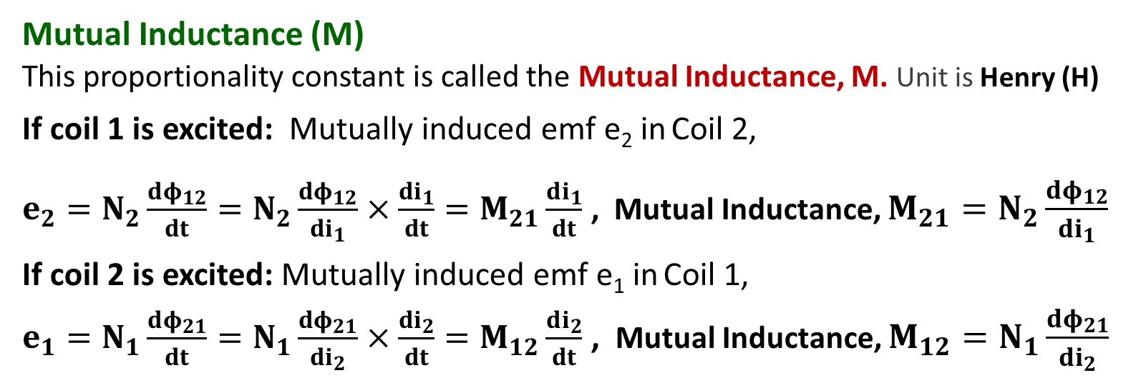
Types of Statically Induced EMF
Mutually Induced EMF
The induced emf in a coil due to the change of flux produced by the change of current in the nearby coil
Mutual Inductance (M)
This proportionality constant is called the Mutual Inductance, M. Unit is Henry (H)
If coil 1 is excited: Mutually induced emf e₂ in Coil 2,
$e_{2}=N_{2}\frac{dφ_{12}}{dt}=N_{2}\frac{dφ_{12}}{{di}_{1}}×\frac{di_{1}}{dt}=M_{21}\frac{di_{1}}{dt}$ , Mutual Inductance, $M_{21}=N_{2}\frac{dφ_{12}}{di_{1}}$
If coil 2 is excited: Mutually induced emf e₁ in Coil 1,
$e_{1}=N_{1}\frac{dφ_{21}}{dt}=N_{1}\frac{dφ_{21}}{{di}_{2}}×\frac{di_{2}}{dt}=M_{12}\frac{di_{2}}{dt}$ , Mutual Inductance, $M_{12}=N_{1}\frac{dφ_{21}}{di_{2}}$
Notes:
Picture Courtesy: Google

Slide 19
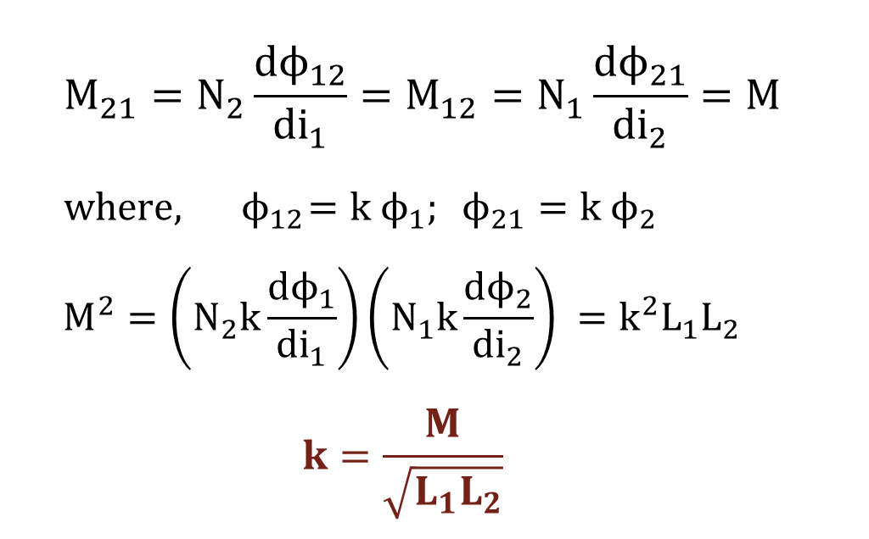
Coupling Coefficient (k)
Gives an idea about the degree of magnetic coupling between two coils.
$$M_{21}=N_{2}\frac{dϕ_{12}}{di_{1}}=M_{12}=N_{1}\frac{dϕ_{21}}{di_{2}}=M$$
$$where, { ϕ}_{12}=k ϕ_{1}; ϕ_{21}=k ϕ_{2}$$
$$M^{2}=\left(N_{2}k\frac{dϕ_{1}}{di_{1}}\right)\left(N_{1}k\frac{dϕ_{2}}{di_{2}}\right) =k^{2}L_{1}L_{2}$$
$$k=\frac{M}{\sqrt{L_{1}L_{2}}}$$
Notes:
Picture Courtesy: Google

Slide 20
Coupled Circuits
Polarity of mutually induced EMF depends on
current direction
physical construction of the coils
Obtaining the dotted equivalent: Right Hand Grip Rule
Place the dot at the terminal directed by the thumb
Notes:
Picture Courtesy: Google

Slide 21
Dot Rule for coupled coils
Dot Rule helps in determining the sign of mutually induced emf without going into the details of physical construction
Dot Rule
If currents enters (or leaves) the dotted terminals in both the coils, the sign of mutually induced EMF is same as that of sign of self-induced EMF. (Additive Coupling)
If the current enters the dotted terminal in one coil and leaves the dotted terminal in the other coil, the sign of mutually induced emf is opposite to that of sign of self induced emf. (Subtractive Coupling)
Notes:
Picture Courtesy: Google

Slide 22
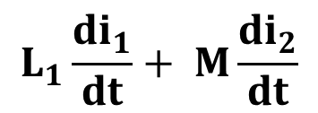
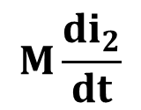
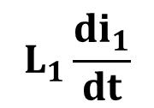
Additive Coupling: (Fluxes are aiding)
$$L_{1}\frac{{di}_{1}}{dt}$$
Self induced emf in L₁ =
$$M\frac{{di}_{2}}{dt}$$
Mutually induced emf in L₁ =
$$L_{1}\frac{{di}_{1}}{dt}+ M\frac{{di}_{2}}{dt}$$
Total induced emf in L₁ =
Notes:
Picture Courtesy: Google

Slide 23
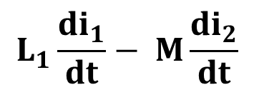
Subtractive Coupling: (Fluxes are opposing)
$$L_{1}\frac{{di}_{1}}{dt}$$
Self induced emf in L₁ =
$$M\frac{{di}_{2}}{dt}$$
Mutually induced emf in L₁ =
$$L_{1}\frac{{di}_{1}}{dt}− M\frac{{di}_{2}}{dt}$$
Total induced emf in L₁ =
Notes:
Picture Courtesy: Google

Slide 24
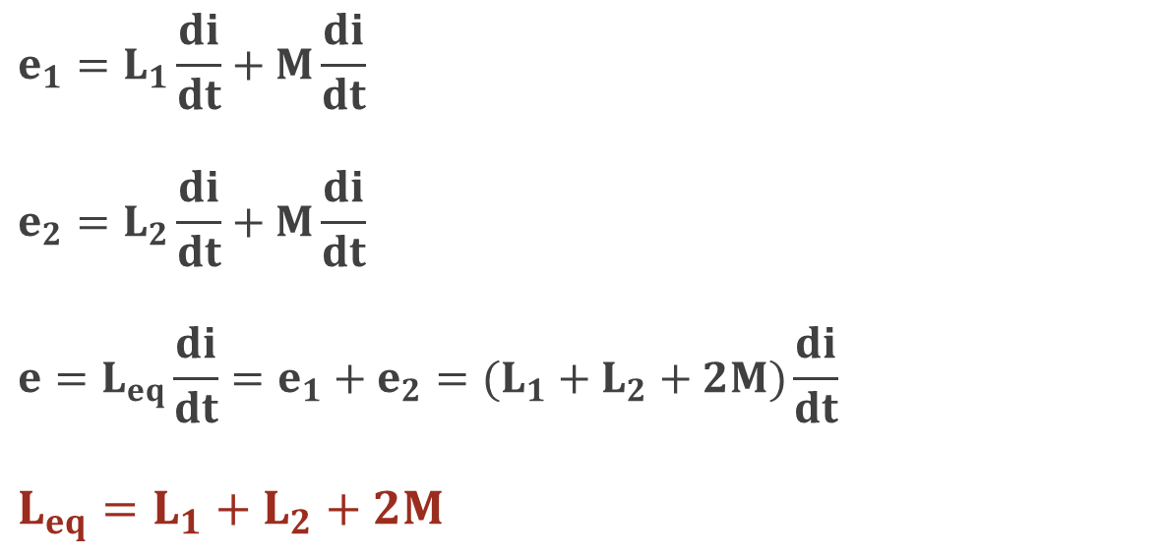
Coupled Coils in Series - Aiding
$$e_{1}=L_{1}\frac{di}{dt}+M\frac{di}{dt}$$
$$e_{2}=L_{2}\frac{di}{dt}+M\frac{di}{dt}$$
$${e=L_{eq}\frac{di}{dt}=e_{1}+e}_{2}=(L_{1}+L_{2}+2M)\frac{di}{dt}$$
$$L_{eq}=L_{1}+L_{2}+2M$$
Notes:
Picture Courtesy: Google

Slide 25
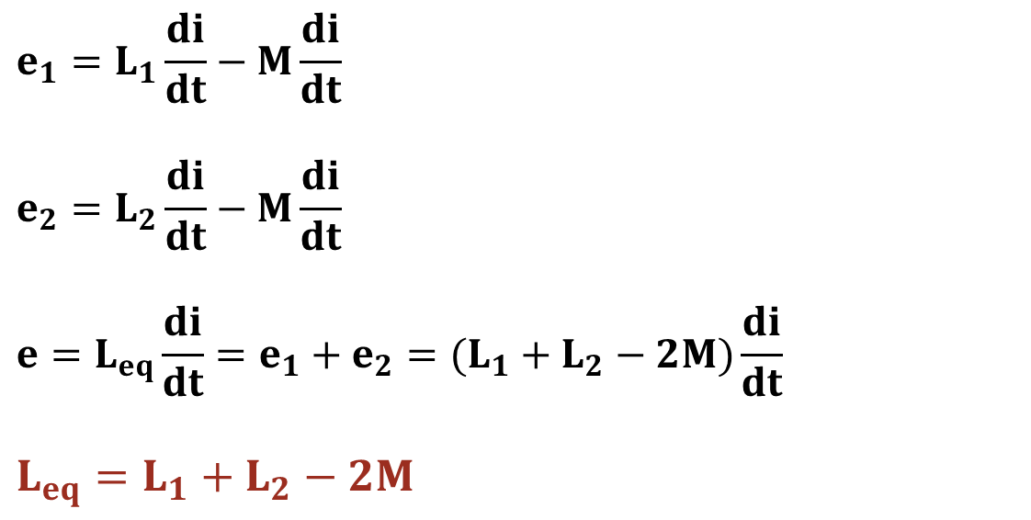
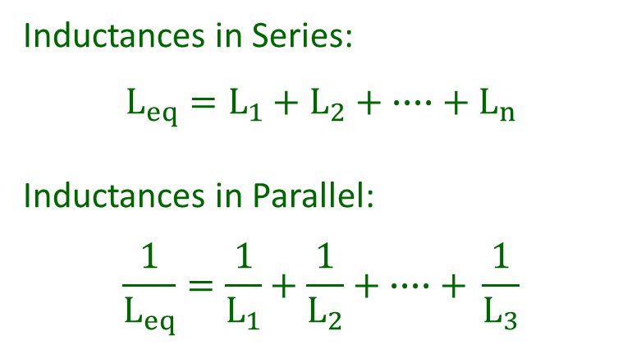
Coupled Coils in Series - Opposing
$$e_{1}=L_{1}\frac{di}{dt}−M\frac{di}{dt}$$
$$e_{2}=L_{2}\frac{di}{dt}−M\frac{di}{dt}$$
$${e=L_{eq}\frac{di}{dt}=e_{1}+e}_{2}=(L_{1}+L_{2}−2M)\frac{di}{dt}$$
$$L_{eq}=L_{1}+L_{2}−2M$$
Inductances in Series:
$$L_{eq}=L_{1}+L_{2}+ ∙∙∙∙+ L_{n}$$
Inductances in Parallel:
$$\frac{1}{L_{eq}}=\frac{1}{L_{1}}+\frac{1}{L_{2}}+ ∙∙∙∙+ \frac{1}{L_{3}}$$
Notes:
Picture Courtesy: Google

Slide 26
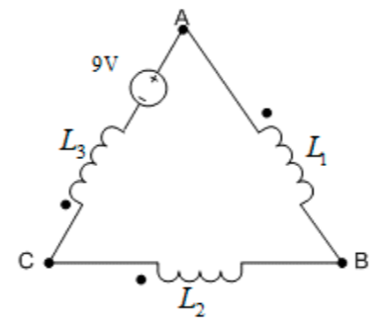

Illustration 8
Three magnetically coupled inductive coils having the following data are connected as shown. L₁ = 0.1 H; L₂ = 0.2 H; L₃ = 0.4 H; k₁₂ = 0.4; k₂₃ = 0.5; k₃₁ = 0.5​. Find the equivalent inductance of the circuit.​
$$Ans: 0.5041 H$$
Notes:
Picture Courtesy: Google

Slide 27

Illustration 9
Three magnetically coupled inductive coils having the following data are connected in series as shown in Figure. L₁ = 0.3 H; L₂ = 0.6 H; L₃ = 0.8 H and the coefficients of coupling are, k₁₂ = 0.8; k₂₃ = 0.75; k₃₁ = 0.5. Draw the dotted equivalent circuit of the figure, also find the equivalent inductance of the circuit.
i
L₁
L₃
L₂
$$Ans:0.472 H$$

Slide 28
Illustration 10
Two coils with inductances in the ratio 4:1 have a coupling coefficient k = 0.6. When these coils are connected in series aiding the equivalent inductance is 44.4 mH. Find L₁, L₂, and M.
$$Ans:\text{L}\text{1}\text{ = 6 }\text{mH}\text{, }\text{L}\text{2}\text{ = 24 }\text{mH}\text{, }\text{and} \text{M}\text{ = 7.2 }\text{mH}$$

Slide 29

Illustration 11
When two identical coils are connected in series, the inductance of the combination is found to be 80 mH. When the connections to one of the coils are reversed, a similar measurement indicates 20 mH. Find the mutual inductance and coupling co-efficient between the coil.
$$Ans:\text{0.015 }\text{H} \text{and}\text{ 0.6}$$

Slide 30
Self-Practice 1
Two similar coils have a coupling coefficient of 0.4. When they are connected in series aiding, the equivalent inductance is 560 mH. Calculate:
Self-inductance of both the coils.
Total inductance when the coils are connected in series opposition.
Total energy stored due to a current of 3A when the coils are connected in series opposition.
Ans: a) 0.2 H, b) 0.24 H, and c) 1.08 J
Notes:
Picture Courtesy: Google

Slide 31
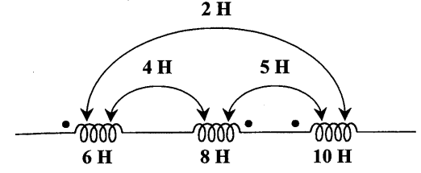
Self-Practice 2
For the three coupled coils, calculate the total inductance.
Ans: 10 H
Notes:
Picture Courtesy: Google

